Slide 1
E-commerce Product Analytics – Technical Case Presentation
Presented By :Ihsaan --Data Specialist from Dadosfera
1

Slide 2
Table of contents
01
02
03
06
05
04
Input Data &
Initial Constraints
Context & Objective
Data Quality
Strategy
GenAI Feature
Engineering
Data Modeling ,
Analytics Layer
Pipeline Design
Data App – Streamlit Dashboard
2

Slide 3
1. Context & Objective (Why this project exists)
Business problem
Dadosfera-style analytics platform needs a reproducible, scalable pipeline to transform raw e-commerce events into decision-ready analytics.
Objective
Design and implement an end-to-end data engineering solution:
From raw transactional data
Through data quality + enrichment (GenAI where justified)
Into analytics-ready models
Served via an interactive dashboard
Key constraint: keep it simple, explainable, and production-oriented (Junior Data Engineer scope).
3

Slide 4
2. Input Data & Initial Constraints
Raw Dataset (Confirmed)
Challenges identified early
Categories are noisy / inconsistent
No semantic tags for analytics
No premium segmentation
Raw data not BI-ready
Column | Description
product_id | Business product identifier
title | Product name
description | Free-text product description
category | Raw merchant category
price | Unit price
quantity | Units sold per order
order_date | Transaction date
region | Sales region
4

Slide 5
3. Data Quality Strategy (Step 4)
What I did ?
Column-level validation
Enforced mandatory fields: product_id, price, quantity, order_date
Removed rows with invalid numeric values (negative price/quantity)
Business logic validation
total_amount = price × quantity consistency
Date parsing enforced to ISO format
Why this matters
Prevents silent metric corruption in downstream aggregations.
Outcome
Clean, deterministic dataset ready for enrichment.
5

Slide 6
4. GenAI Feature Engineering
Why GenAI was used
GenAI was not used randomly.
Used only where rule-based logic fails:
Semantic category normalization
Product tagging from unstructured text
Premium product classification
6

Slide 7
4. GenAI Feature Engineering
GenAI Outputs Added
Column | Purpose
normalized_category | Analytics-friendly category taxonomy
product_tags | Semantic attributes (e.g. portable, durable)
product_summary | Compact business-readable description
is_premium_product | Boolean segmentation for revenue analysis
Design decision
LLM outputs are deterministic, JSON-parsed, and schema-controlled to avoid hallucination risk.
7

Slide 8
5. Enriched Dataset Result
Final enriched dataset columns:
product_id
price
quantity
order_date
region
normalized_category
product_tags
product_summary
is_premium_product
This dataset becomes the single source of truth for analytics.
8

Slide 9
6. Data Modeling – STAR Schema (Step 6)
Why STAR schema
Final Model (No Over-Engineering)
Fact Table – fact_sales
product_id (FK)
date_id (FK)
region_id (FK)
quantity
unit_price
total_amount
Dimensions
dim_product (GenAI-enriched attributes)
dim_date (calendar breakdown)
dim_region (geography)
Why this works
Supports slicing revenue by category, region, time with minimal complexity.
BI-friendly
Simple joins
Industry standard (Dadosfera compatible)
9

Slide 10
7. Analytics Layer (Step 7)Key Analytical Questions
Answered
Revenue by category
Revenue by region
Units sold trends
Premium vs non-premium contribution
SQL-style Aggregations
All metrics are derived from fact_sales, ensuring:
No duplicated logic
Metric consistency across dashboards
10

Slide 11
8. Pipeline Design (Step 8 – ETL)
Pipeline Stages
Extract – CSV ingestion
Transform
  Data quality enforcement
  GenAI enrichment
  Metric computation
Load
  Aggregated analytics output
  Persisted as sales_pipeline_output.csv
Why CSV Output
Lightweight
Versionable
Perfect for demo + BI tools
Pipeline is idempotent and re-runnable.
11

Slide 12
9. Data App – Streamlit Dashboard
Why Streamlit
Fast deployment
Python-native
Ideal for analytics demos
Dashboard Architecture
Reads pipeline output (no recomputation)
Filter-driven analytics
Plotly-powered visualizations
Implemented Features
Filters
Region
Normalized Category
KPIs
Total Revenue
Units Sold
Avg Revenue per Unit
Visuals
Revenue by Category (interactive bar chart)
Revenue by Region (interactive bar chart)
Data Transparency
Raw data viewer (filtered)
12

Slide 13
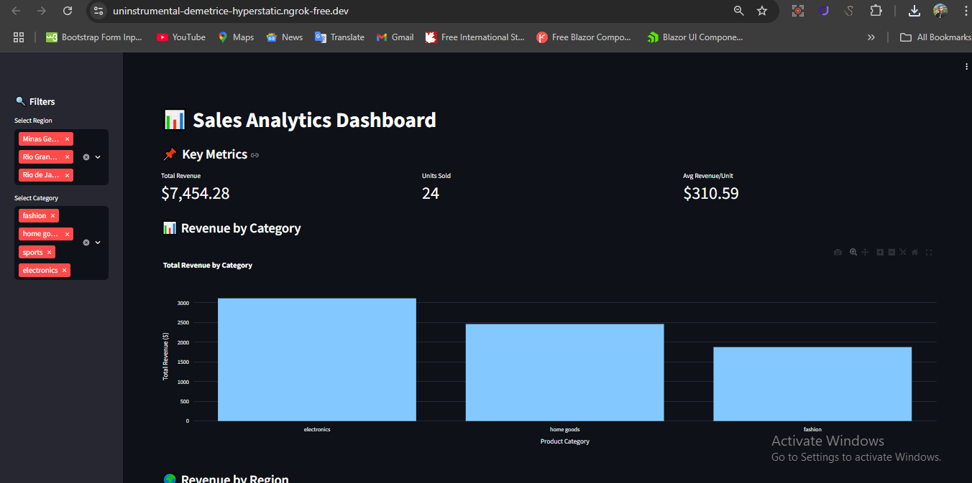
9. Data App – Streamlit Dashboard
13

Slide 14
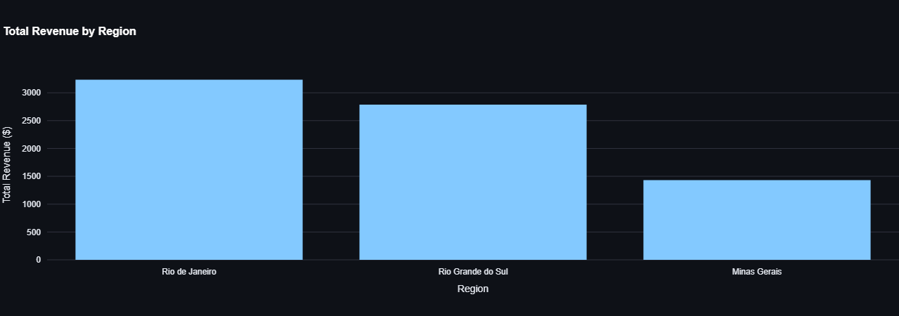
9. Data App – Streamlit Dashboard
14

Slide 15
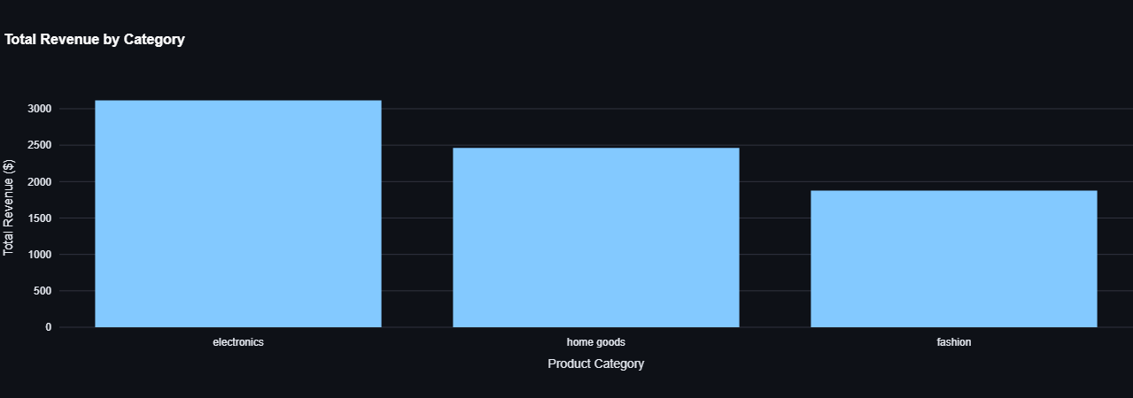
9. Data App – Streamlit Dashboard
15

Slide 16
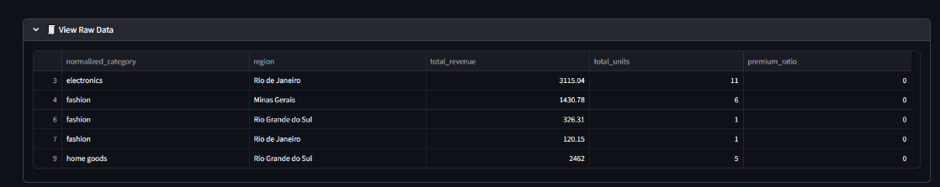
9. Data App – Streamlit Dashboard
16

Slide 17
10. Engineering Decisions
No hard-coded values
Error-safe file loading
Schema validation before visualization
Clear separation of pipeline vs app
GenAI used only where it adds value
This shows engineering judgment, not just coding.
17

Slide 18
11. Outcome & Business Value
What this system enables:
Faster category-level insights
Cleaner revenue reporting
Premium product segmentation
Scalable analytics foundation
Ready for:
BI tools
Cloud storage
Orchestration (Airflow, Dagster)
18

Slide 19
12. Final Takeaway
This project demonstrates how to go from messy transactional data
to a clean, enriched, analytics-ready system using pragmatic data engineering principles.
End-to-end. Explainable. Production-minded.
19

Slide 20
Thanks!
Do you have any questions?
20

